Slide 1
C# Call GraphQL API

Slide 2
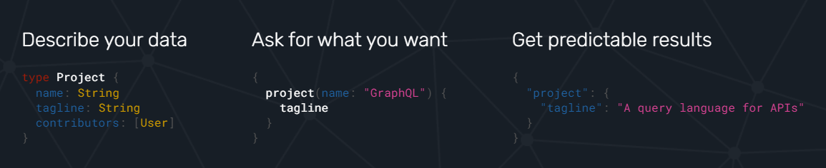
What is GraphQL API?
https://graphql.org
A query language for your API
Schema Query Result

Slide 3
Why GraphQL?
Provides a complete and understandable description of the data in your API
Clients can ask for exactly what they need and nothing more
Easy to evolve APIs over time
Enables powerful developer tools

Slide 4
GraphQL over REST
Single endpoint vs multiple endpoints
Flexible structure in return data vs fixed
Strongly typed vs weakly typed
Invalid requests are automatically checked vs manually checked
Notes:
https://aws.amazon.com/compare/the-difference-between-graphql-and-rest

Slide 5
How to consume a graphql API?
Using Strawberry.Shake https://chillicream.com/docs/strawberryshake/v13/get-started/console
Public GraphQL APIs for testing
https://github.com/graphql-kit/graphql-apis

Slide 6
Step 01 - Install Strawberry Shake locally
Create a project, let’s say WpfApp1
Open terminal with Ctlr + `
Go up to the parent directory of the solution
Install manifest-tool
$ dotnet new tool-manifest
Install the Strawberry Shake tools
$ dotnet tool install StrawberryShake.Tools --local

Slide 7
Step 02 - Install server
(Still in the parent directory of the solution)
Add Strawberry package to our code generation
dotnet add WpfApp1 package StrawberryShake.Server

Slide 8

Step 03
Add a GraphQL client to your project using the CLI tools
Let’s say your url is: https://graphql.anilist.co
dotnet graphql init https://graphql.anilist.co -n AnimeClient -p ./WpfApp1
dotnet graphql init localhost:4000/graphql -n MyShopClient -p ./TestGraphql
Customize the namespace of the generated client to be WpfApp1.GraphQL
Head over to the .graphqlrc.json
Insert a namespace property to the StrawberryShake section.

Slide 9
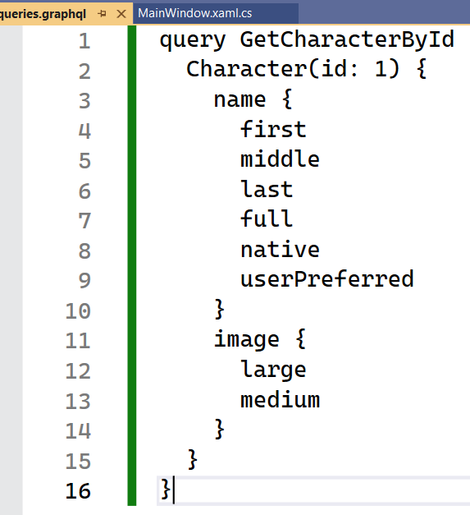
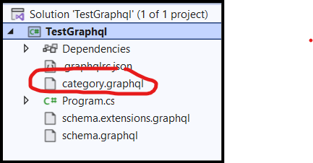
Step 04 - Write your queries (text file then rename)
Create a file queries.graphql
to store your queries
Or: category.graphql

Slide 10
Step 05 - Build the project (Ctrl + Shift + B)
Inspect folder: obj/Debug/net9.0/berry
You should found an auto-generated class named: MyShopClient.Client.cs

Slide 11
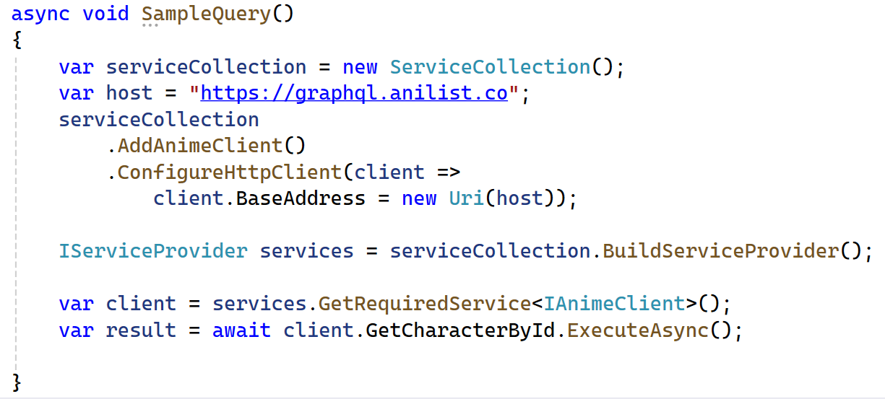
Step 06 - Fetch the data
Notes:
var serviceCollection = new ServiceCollection();
var host = "https://congenial-space-pancake-7q66wpqx5cpgrq-5000.app.github.dev/graphql";
serviceCollection.AddMyShopClient()
.ConfigureHttpClient(
client => client.BaseAddress = new Uri(host));
var services = serviceCollection.BuildServiceProvider();
var client = services.GetRequiredService<IMyShopClient>();
var result = await client.AllCategories.ExecuteAsync();
foreach(var item in result.Data!.AllCategories!.Nodes) {
Console.WriteLine($"{item!.Id} - {item.Name}");
}

Slide 12
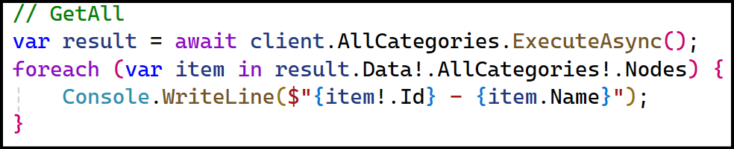
Ví dụ lấy AllCategories

Slide 13
Tham số hóa query

Slide 14
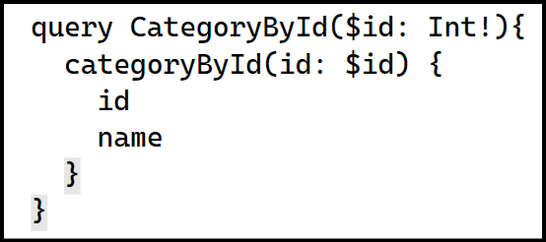
Bước 1: Cập nhật category.graphql, bổ sung

Slide 15
Bước 2: Biên dịch
Chạy lại lệnh init
dotnet graphql init localhost:4000/graphql -n MyShopClient -p ./TestGraphql
Biên dịch lại với Ctrl + Shift + B

Slide 16
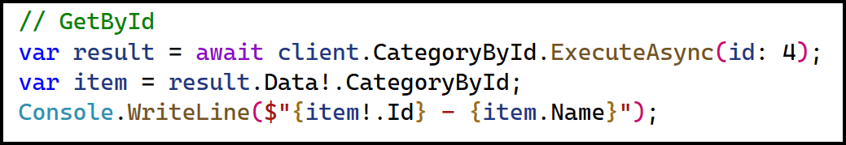
Bước 3: Gọi API
Chú ý chỗ truyền đối số là tham số của hàm ExecuteAsync.

Slide 17
DeleteById

Slide 18
Bước 1: Cập nhật query

Slide 19
Bước 2: Biên dịch lại
Chạy lại lệnh init
Biên dịch lại với Ctrl + Shift + B

Slide 20
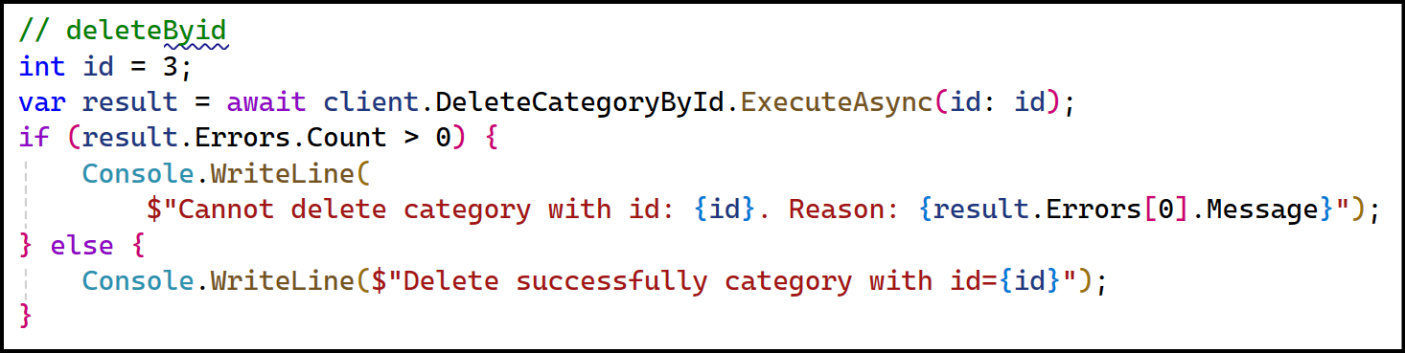
Bước 3: Mã nguồn và xử lí lỗi

Slide 21
UpdateById

Slide 22
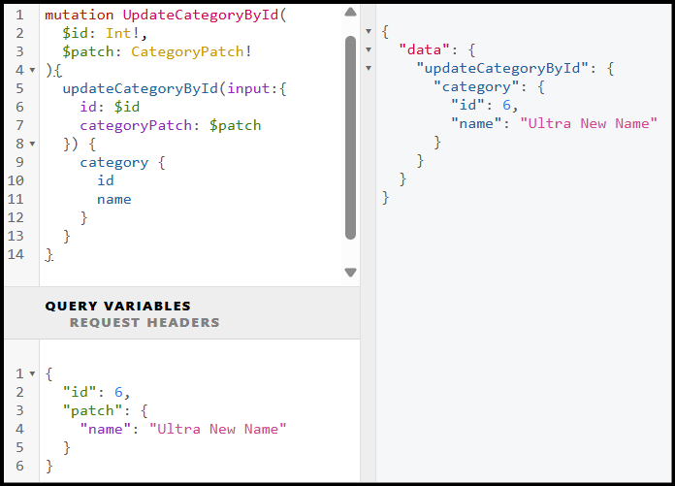
Bước 1: Bổ sung câu query

Slide 23
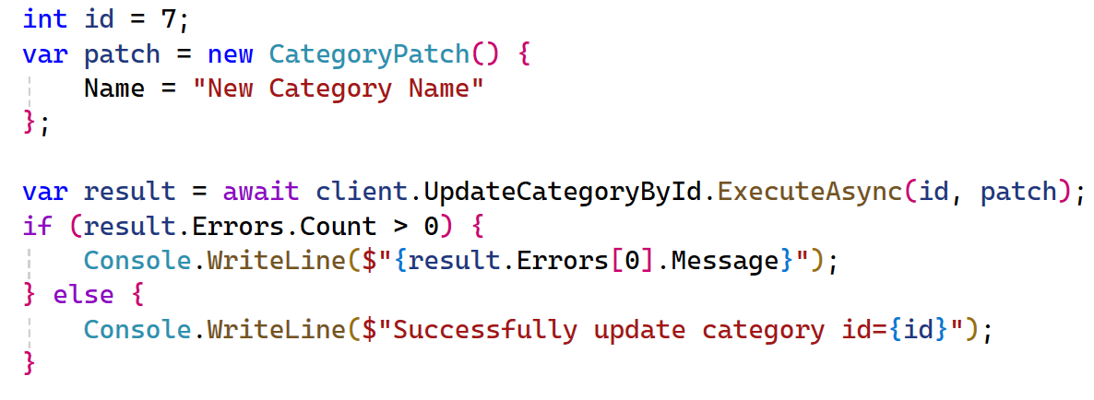
Bước 2: Mã nguồn

Slide 24
Create

Slide 25
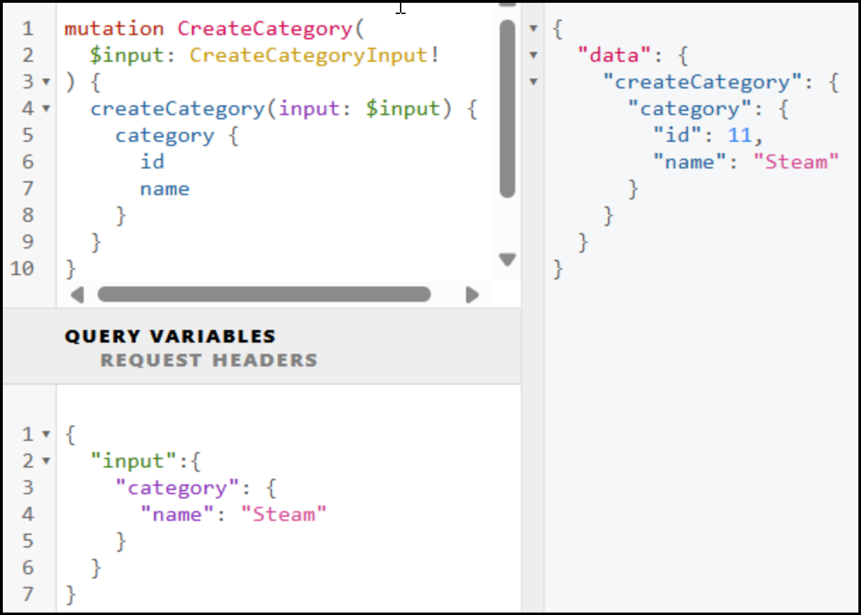
Bước 1: Cập nhật query

Slide 26
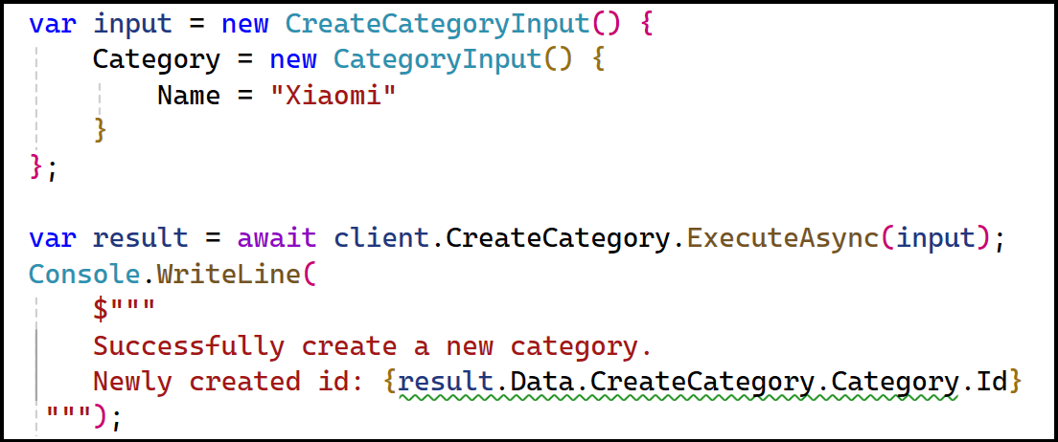
Bước 2: Mã nguồn

